Slide 1
Online Auction System
Presented By: -
Team 35
Mobility Pune

Slide 2

Contents
Introduction
Literature Review
Problem Statement
Technical Specification
Design Overview
System Database Structure
Screenshots
Limitations & Future Scope
Conclusion
References

Slide 3

Introduction
Best value is an online auction website which provide facility for buying and selling goods by offering them up for bid, taking bids, and then selling the item to the highest bidder.
There are two categories of persons
one is customers and other is vendor
Vendor can sell his products on this website and customer will purchase it.
Product will be given to those customer who put a high bid price on product to purchase.

Slide 4

Literature Review
Auction of art has been there since the 17th century. It has even become an important source of income to some companies.
Companies that engage in art based lending hope to attract more collectors.
Many websites and software and systems have been developed for doing online art auction.
Online auction is a market determining resource allocation and prices on the basis of bids from market participants.

Slide 5
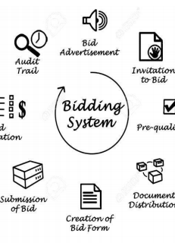
Problem Statement
In the existing system, auctions involves showcasing and selling of valuable arts and antique items.
The user is not able to get the required information about the products to be purchased.
The auction houses are for the
selected few people with ticket
to attend which limits the people.
Bidders who need to buy there
things than he attend the place
of bidding.

Slide 6
Technical Specification
Hardware Specification
Hardware interface we used the Core i3 is the third line in Intel's Core "i" branding (i3). The Core i3 7th generation laptop is used in our project. Developed and manufactured by Intel, the Core i3 is a computer processor, available as dual-core or quad-core. 4 GB+ RAM. 4 GB storage will be required.
Software Specification
S. No. | Name of Component | Specification
1 | Operating System | Windows 10
2 | Language | Java, JS, HTML
3 | Database | Derby DB
4 | Browser | Net Explorer
5 | Web Server | Apache
6 | Software Development Kit | JDK 1.8 Version Eclipse

Slide 7
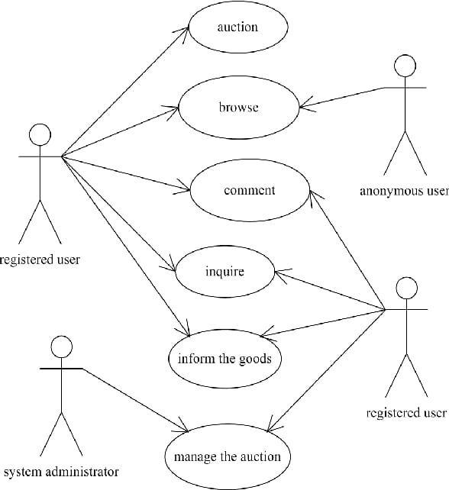
Use Case Diagram

Slide 8
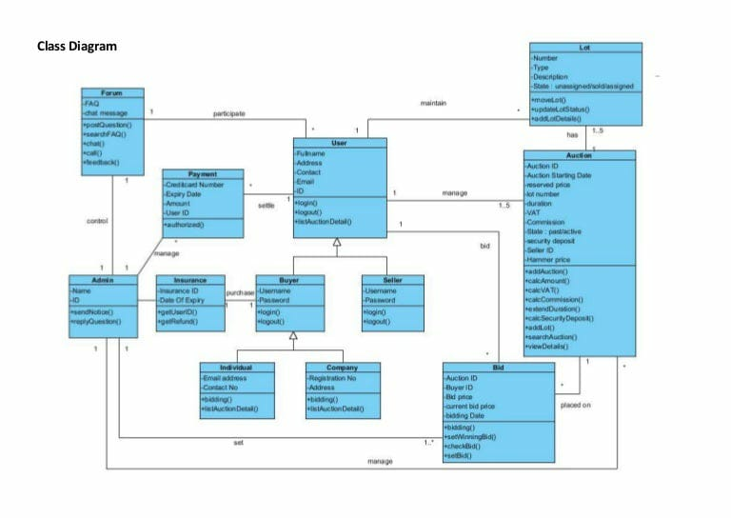
Class Diagram

Slide 9
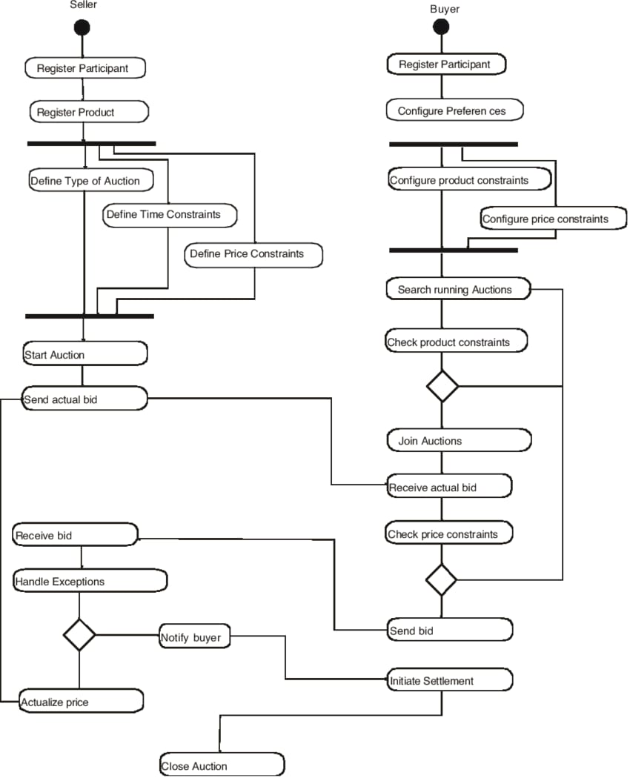
Activity Diagram

Slide 10
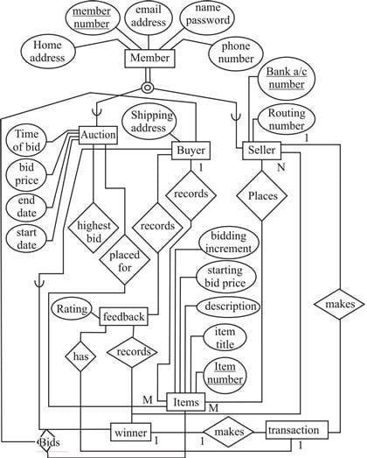
ER-Diagram

Slide 11
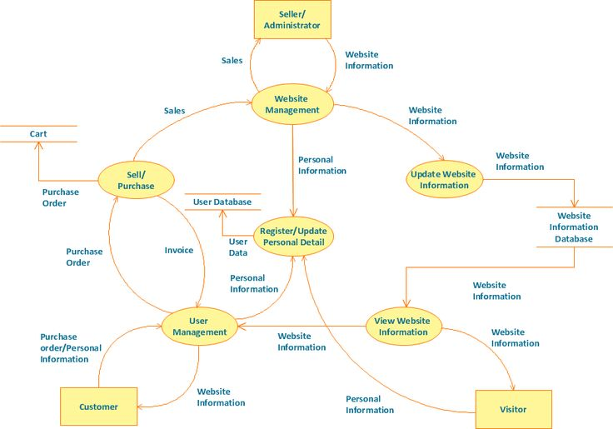
Data Flow Diagram

Slide 12
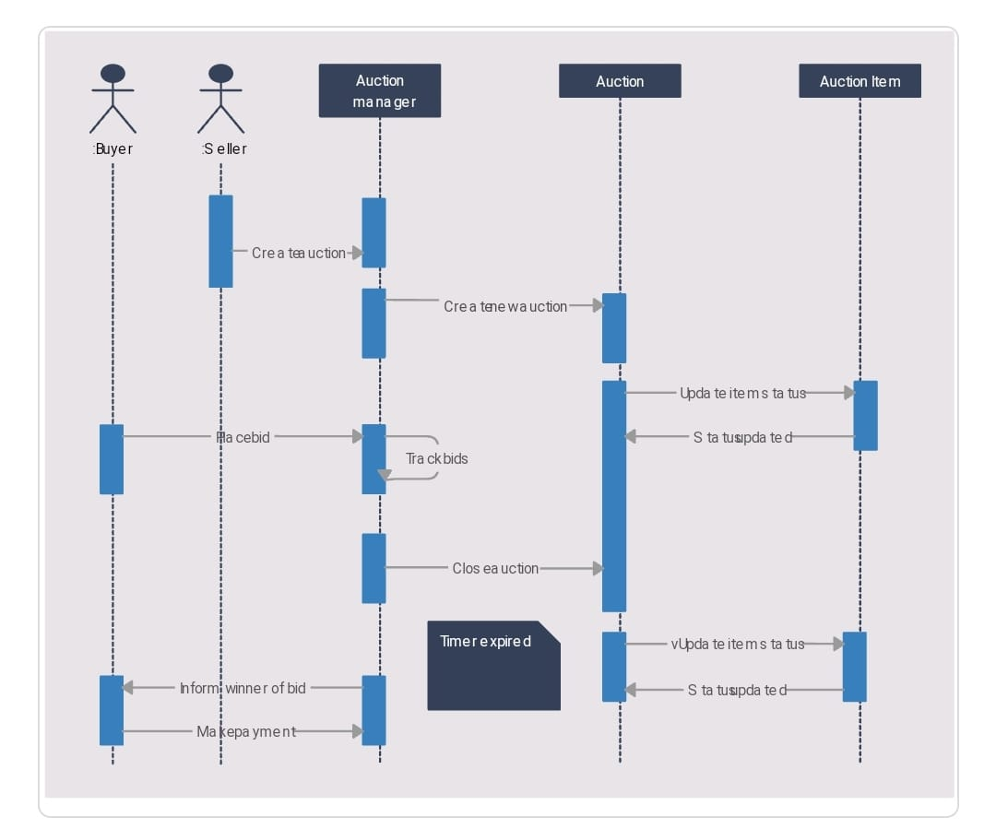
UML Diagram

Slide 13

Limitations & Future Scope
There is no online payment option in this application so we will further enhance it by using payment get way.
We can add messaging system for all user to communicate with each other any time.
We can verify user’s email for security purpose and also to notify them about the auctions.
We also plan to enhance the interface so that it will be more user friendly.

Slide 14

Conclusion
Best value provides user to sell their items to a larger number of prospective buyers and to find items for a lot cheaper price than the commercial market.
Online auctioning has been particularly useful for buyers looking for used merchandize as it is tough to find at stores.
Auction web application bridges a gap between companies that have equipment to sell and companies looking for used but in good condition business equipment to buy.

Slide 15
Team Members
Aishwarya Yadav
Amisha Sharma
Ananya Verma
Avish Shukla
Anurag Raj
Anshul Gupta
A Kunaal Bokadia
Shreyansi Chaurasia

Slide 16
References
https://en.wikipedia.org/wiki/Online_auction
https://digitalcommons.unomaha.edu
https://slideplayer.com
https://ukdiss.com
https://www.ukessays.com
http://pro.unibz.it

Slide 17

Thank You

